Slide 1
Agenda
Introduction
Case Study
Challenges
Improvement Areas
Risk Mitigation
Summary

Slide 2
Introduction : Developing Supply chain strategy for MTC
Medical Technologies Corporation (MTC)
Headquarter - Collegeville, Pennsylvania
Business – Surgical Devices Manufacturer & seller
CFO : Peter Sampras
Chief Supply Chain Officer : Chris Evert
Business Challenge:
A Newly imposed Affordable care act (ACA) Medical device Excise Tax of 2.3% of revenue. The surgical devices that the firm sells puts them squarely into the focus of this tax, and after taxes, 2.3% of sales translated into over 10% reduction in MTC’s profits.
This would ensure that no one in the corporation would get their annual bonus, or worse, lay-offs might be considered
Strategic Goal:
Identify cost levers that will help to offset the tax of 2.3% of revenue.
Provide improvements in current Supply chain logistics & planning
Improve the supply chain operational efficiencies
Identify supply chain sourcing issues and provide suggestions.

Slide 3
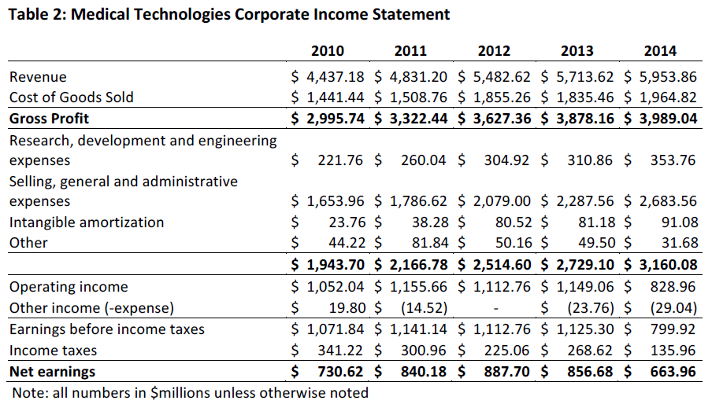
Case Study : MTC Corporate Income Statement Analysis
cv
MTC Income Statement Analysis
Revenue growth is slowing down
Gross profit is lowering year on year
Net earnings are reducing
Operating income is going negative compared to other competitors

Slide 4
Challenges : Current Supply Chain Logistics
48 hours
Transport
Sterilization
(offsite)
Key Logistics PoC
GPOs
Offsite Sterilization unit
Multiple inventory Locations
Sales Rep. stores “trunk stock”
Transportation
Transport
Transport
Manufacturing Units
Distributors
(Central/Regional)
Health care providers
Hospital Rooms
Central Supply
Transport
3PL
Transport
Sales Rep

Slide 5
Improvement Areas : Actions to reduce operational cost to help offset 2.3% tax on revenue
Short Term Actions
Long Term Actions
Sales Rep Optimization
Limited Sales Rep (SR) for PPI supply only (no inventory control)
Limit SR incentives
Operations Optimization
Sterilization to move inhouse (outsource)
Reduce cost of transport
Improve strategic partnership
Optimize Inventory
“Smart Kiosks” Store at hospital locations
Kiosk Distribution to provide last mile visibility of supply chain
Operations Optimization
RFID enabled inventory/supply chain tracking
JIT/Lean Production & Supply
Align inventory closer to hospitals (distributor NW to direct Model)
Outcomes
Reduction in operational Cost
Increase Operating Margin
Reduce inventory turnover
Improve strategic relationship with hospitals
Automation in business process

Slide 6
Risk & Mitigations
Risks | Mitigations
Revenue Reduction Surgeons Relationship impact due to sales rep (SR) reductions | Realign SRs to connect with surgeons only to PPI (Physicians Preference Items)requirements. SRs to limit surgeons connects
Market credibility impact due to change in distribution model and production (JIT) | Agile adoption of the process improvements. Automation to improve process visibility (like analytics in demand/supply)
Loss of revenue due to issues in production line/distribution line | Work in phased manner to start smart kiosk, RFID, JIT/Lean production

Slide 7
Summary
Business Challenge:
2.3% cost savings to offset the new ACA tax on revenue.
Improvement Areas:
Financial Benefits:
By Implementing this actions, the operational cost will reduce to mitigate the tax impact
Realign the sales rep model and functions
Reduce cost of transport
Improve Strategic Relationship with hospitals
Implement “Smart Kiosks” & RFID technology
Inhouse Sterilization unit (outsource)
Align inventory closer to hospitals
Lean/JIT production & Supply

Slide 8
Thank You

